Slide 1

Smart Closet
MDP25-19
Fatima Al Rabih
Karen El Khoury
Lea Chamseddine
Marilyn Abou Tayeh
ESIB Multidisciplinary Project
May 2025
Supervised by:
Dr. Hanan Farhat

Slide 2
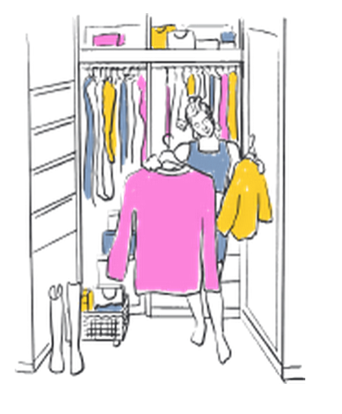
Introduction
Problem identification:
Involves diverse stakeholders, including regular people/clients, mobile developers, Ai engineers, fashion specialist.
Contains multiple component parts and technical issues , including image processing, AI suggestion algorithms, backend integration, data processing and IOT
Requires a multidisciplinary approach: Mobile developement, machine learning, and data analytics.
Notes:
Headache … Most of us rely on memory, dig through piles of clothes, or just end up wearing the same few pieces over and over. That means forgotten favorites, wasted closet space, and last-minute outfit stress—especially when you're trying to dress for the weather or a special occasion. in reality ...
We are Karenlea fatima marylin CCE STudent and we present to you Smart closet, our project addresses a complex engineering.......
It's not just one taskit's a system with many components working together. That’s why we designed a smart system combining computer vision, machine learning, and data analytics to automate and optimize the experience.

Slide 3
Project Objectives and Outcomes
Objective / Feature | Description | Discipline Involved
📷Camera-Based Inventory Tracking | Automatically detects items via camera when added/removed | Computer Vision, AI, IoT
👗Outfit Suggestion | Recommends outfits based on weather and occasion | AI, Data Analysis
📱Mobile App Integration | A user-friendly app that puts the smart closet right at the user's fingertips | Mobile App Development
📊Clothing Usage Analysis | Highlights most-used, forgotten items, and wardrobe calendar | Data Analytics, Backend Development

Slide 4
Project Functional Requirements
Closet prototype
Offer a user-friendly mobile application for wardrobe management.
Use a camera to capture clothing items entering and exiting the closet.
Detection model to classify and extract the image from the background and detect the clothing item (Top, pants, skirt, and so on)
Provide AI-powered outfit suggestions based on user preferences, weather, and occasion.
Analyze clothing usage patterns and provide insights.
Operate with low power consumption.

Slide 5

Project Constraints
Technical constraints
Provide AI-powered models that have a low response time.
Operate with low power consumption.
Non-technical constraints
The system should be easy to use.
The mobile app should be user-friendly.
Ensure privacy and data security.
The solution should be affordable.

Slide 6
Related Works
Similar Projects | Main strength | Limitations | Differences from SmartCloset
Lucy's Smart closet | AI outfit planning Gesture & lighting features | Very Expensive setup (nfc chips) | Smart Closet uses computer vision, not NFC making it less expensive
ACloset | AI tagging + analytics Cloud access Social outfit sharing | Manual uploads Glitches Crowded interface | ACloset relies on user input with no IoT integration, whereas Smart Closet provides automation
Samsung Family Hub™ Fridge | Smart home integration Meal planning + inventory Energy monitoring | Pricey Interface issues Limited to kitchen use | Smart Closet focuses on wardrobe, not food.

Slide 7
Solution design (1/2)
Multiple design alternatives
Method | Advantages | Disadvantages
Manual Input via Mobile App | Simple implementation Low / no cost | Excessive manual effort No real-time tracking
RFID Tracking on Clothes | Real-time tracking No need for light or good exposure | Expensive Tags are not washable Still requires manual classification
Camera + AI-Based Tracking | Real-time inventory tracking Automated system User-friendly and scalable | Complex implementation May still require some manual verification
Notes:
In this section, we are exploring 3 different solutions for implementing a Smart Closet, establishing the pros and cons of each, and choosing the best solution design for the project while taking into consideration the technical requirements.

Slide 8
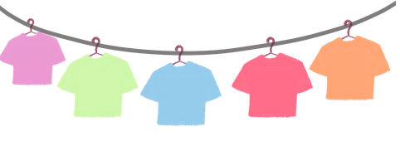
Solution design (2/2)
Problem formulation
Managing a wardrobe is time-consuming. This project leverages camera
based detection and AI to:
Automatically track clothing items.
Suggest outfits (weather/occasion-aware).
Provide usage analytics via a local mobile app.
Goal: An intelligent, energy-efficient system to simplify wardrobe management.

Slide 9
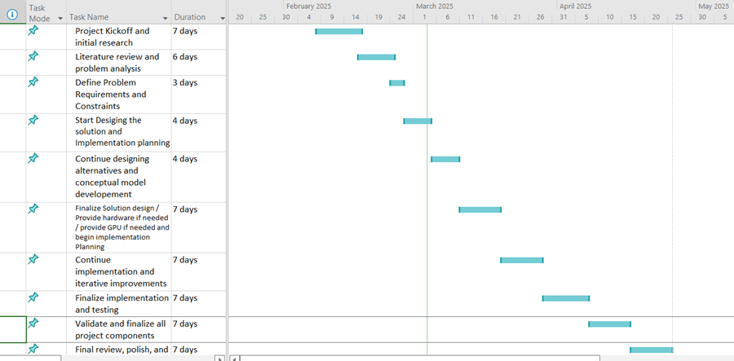

Project Management
Project planning
Conflict Management
Encouraging Open Dialogue and Active Listening
Implementing Collaborative Problem-Solving Techniques
Leveraging Conflict Management Styles
Focusing on Emotional Intelligence
Engaging a Neutral Third Party When Needed

Slide 10
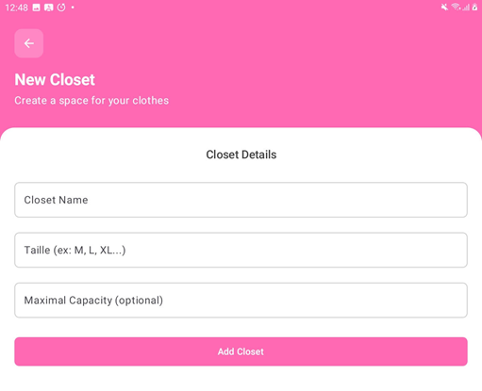


Solution Implementation (1/12)
General Architecture​
Postgresql database + Supabase​
FastAPI backend​
Android app (Kotlin)​
Arduino + sensors (IoT)
User Interface (UI)
Android Studio
Kotlin
Jetpack Compose

Slide 11
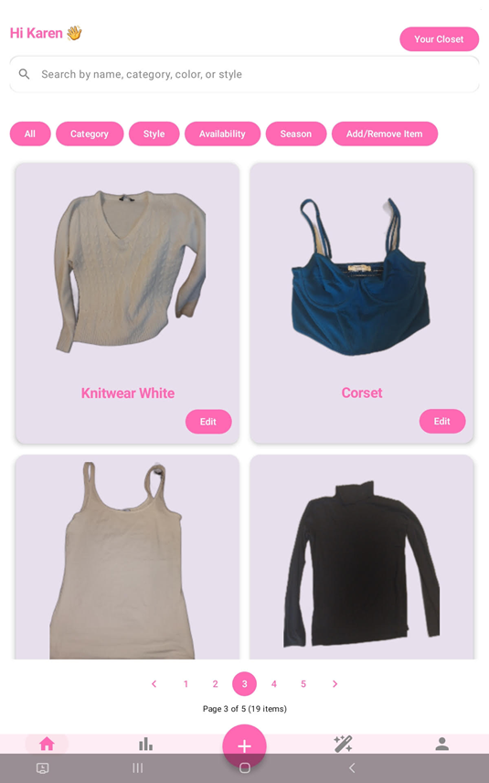
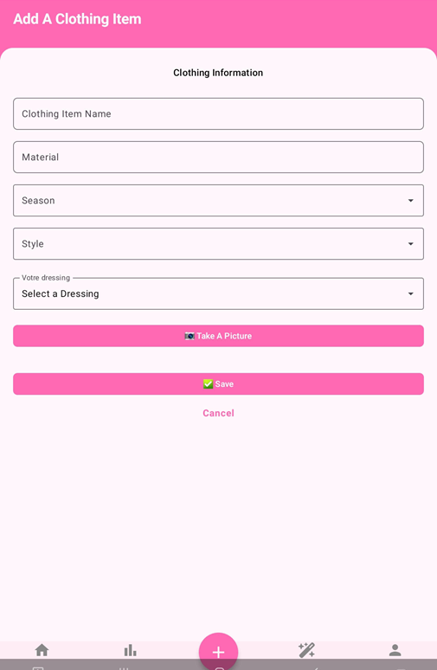
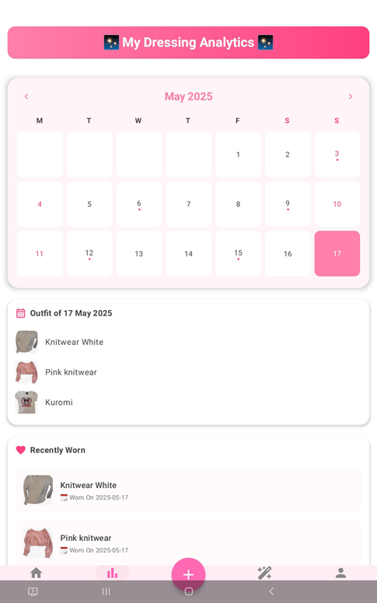
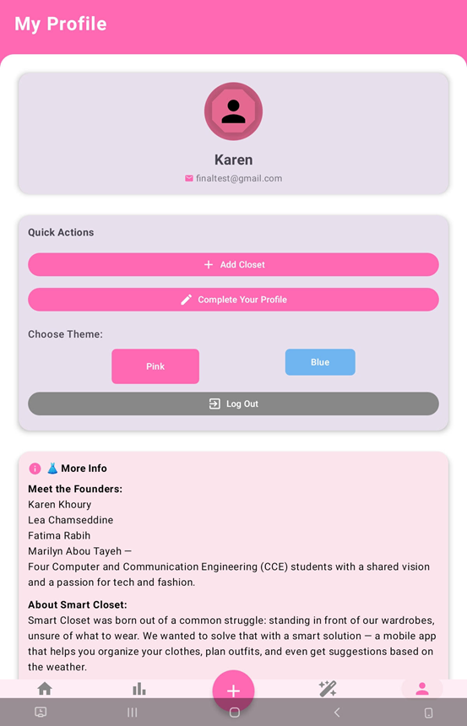
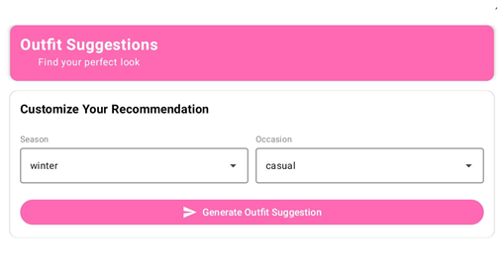
Solution Implementation (2/12)
User Interface (UI)

Slide 12
Solution Implementation (3/12)
Mobile Developpement
Kotlin + Jetpack Compose for modern, declarative UI
MVVM Architecture: clear separation of concerns
ViewModel: business logic & state handling
Repository: data access via Supabase
Reactive UI Composables: StateFlow
🔐 Supabase Integration
Authentication via Supabase Auth
Database operations via supabase-kt SDK
supabase.from("clothingitem") .select { filter { eq("closet_id", id) } }
File upload to Supabase Storage (images)

Slide 13



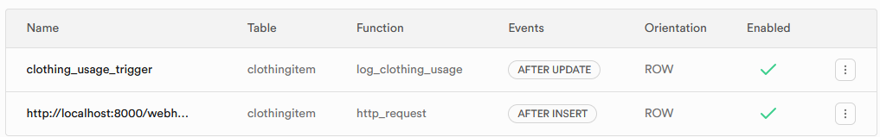
Solution Implementation (4/12) Database and Backend
Relational database - Postgresql
Structured schema and complex queries
Easier to model real-world logic:
1 user → many closets → many items
Backend-as-service - Supabase
Open-source, based on PostgreSQL
Authentication
Database
Storage - Buckets
Webhooks and Triggers
Direct Kotlin support with supabase-kt SDK
6 tables:
User
Closet
Clothing Item
Usage
OutfitRecommend
OutfitRecomItem
2 views:
Forgotten items
Top 3 items Used

Slide 14




SmartCloset Server
Solution Implementation (5/12)​
Serves the backend locally​
Rapid development & testing (FastAPI)​
Avoids premature cloud deployment​
exposes localhost to the Internet via a secure tunnel​
Makes local development instantly accessible to Supabase & mobile app​
Auto-generated documentation with OpenAPI ​
Lightweight syntax, rapid prototyping

Slide 15
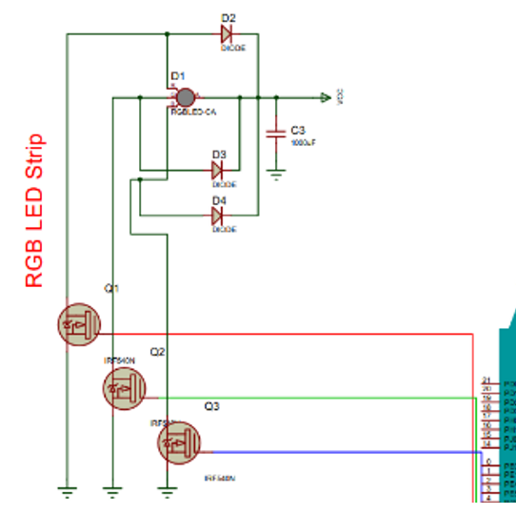
Solution Implementation (6/12)
IOT Automation – Arduino Uno
HC-SR04 ultrasonic sensor
HC-05 Bluetooth module
Keeps track of door position (critical distance 50 cm )
Send ALERT trigger to mobile app for the camera​ to launch
RGB LED strip (12V)
lights up when door opens​ for better vision and aesthetic purposes
3 × IRF540N N-channel MOSFETs
classic open-drain circuit used to control a LED strip (12V) using Arduino Uno (5V logic)
RGB red strip circuit with the arduino uno board

Slide 16
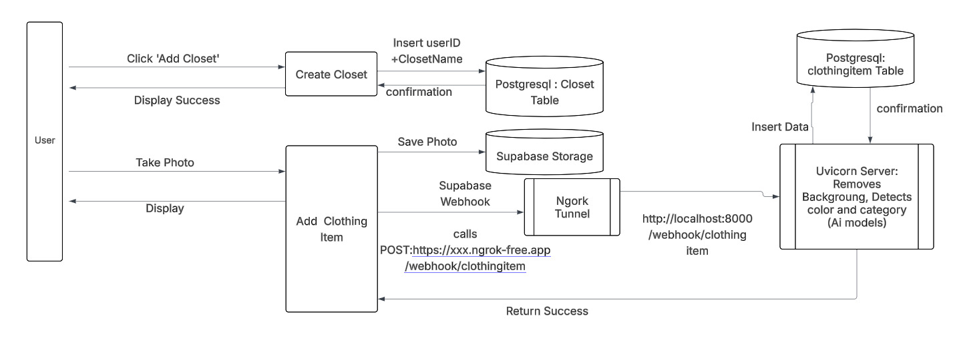
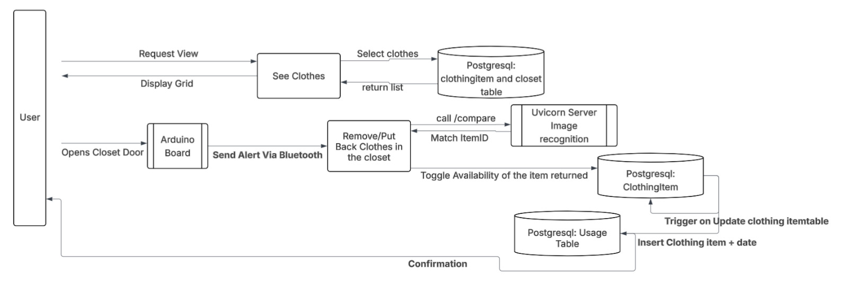
Solution Implementation (7/12)
Data Flow Diagrams

Slide 17
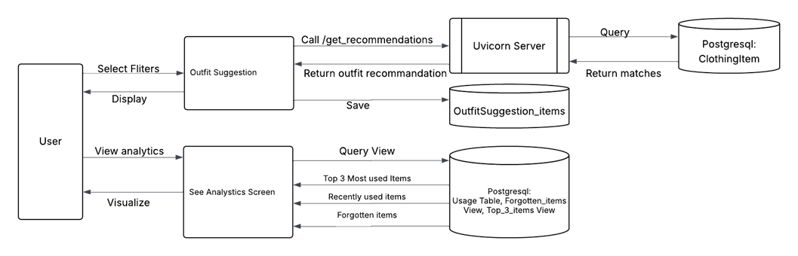
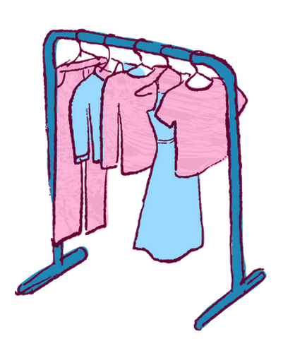
Solution Implementation (8/12)
Data Flow Diagrams

Slide 18
Solution Implementation (9/12)
AI Subsystem Modules:
Component | Purpose | Key Libraries/Tools
Computer Vision | Image processing and feature extraction | OpenCV, scikit-image
Data Processing | Metadata handling and analysis | pandas
Background Removal | Precise garment segmentation | rembg
Object Detection Model | Clothing detection and classification | ultralytics (YOLOv8), torch
Color Classification | Dominant color extraction | OpenCV, numpy, scikit-learn (KMeans), matplotlib, pandas

Slide 19
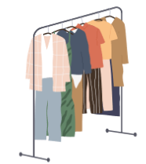
Solution Implementation (10/12)
YOLOv8 Object Detection Model – Implementation
Model Overview
Architecture: YOLOv8x (extra-large version for complex tasks)
Goal: Real-time fashion object detection & classification
Dataset
Source: Roboflow - Main-Fashion v5
Structure: train/, valid/, test/ folders + data.yaml (includes 8 class labels pants, shirt, dress, Tshirt, jacket, short, skirt, and sweater)
Model Training
Epochs: 30, Image Size: 640x640, Batch Size: 16
Optimizer: AdamW (auto-selected)
Features: Mixed Precision, Automatic learning rate/ momentum tuning

Slide 20

Solution Implementation (11/12)
Image Preprocessing Pipeline
Segmentation: Multi-stage garment isolation
Background Removal: rembg (U²-Net) for precise cutout
Cropping: Adaptive bounding box with padding
Resizing: Lanczos interpolation for dimension standardization
Centering: Object placed on transparent canvas
Color Classification Module
Convert image (BGR → RGB)
Segment clothing using GrabCut algorithm
Extract dominant colors via K-Means
Convert RGB → HEX
Match to nearest dataset color using Euclidean distance

Slide 21

Solution Implementation (12/12)
Visual Similarity :
Feature Extraction: ORB algorithm for key points & binary descriptors (efficient, robust)
Feature Matching: Brute-force matcher + Hamming distance, threshold filtering
Similarity Scoring: Ratio of strong matches / total key points ->interpretable percentage
Recommendation Engine:
Metadata filtering (season, occasion)
Color harmony via predefined compatibility matrix (for example, red with black/white)

Slide 22
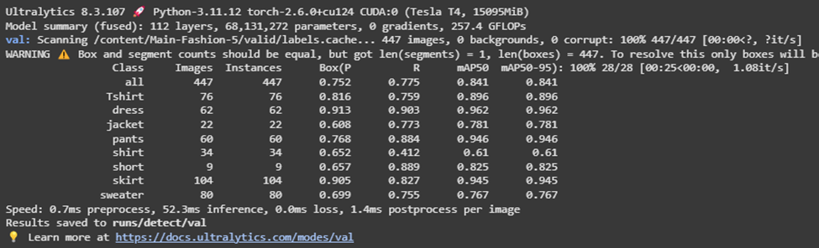
Results and Analysis
YOLOv8 – Validation Results
Metrics
Precision: 0.752
Recall: 0.775
mAP@0.5:0.95 = 0.841

Slide 23
Testing, Evaluation and Iterative improvements (1/2)
Testing method 1: Iterative Improvements
Version | Improvement Description
v1.0 | Initial test with basic dataset and background running camera
v1.1 | Implemented Ultrasonic sensor and Changed camera behavior to require manual capture
V1.2 | Modified the “Alert” Arduino behaviour on the door opening
v1.3 | Replaced AI training dataset with larger, more diverse set
v1.4 | Planned: Personalized model based on user preferences

Slide 24
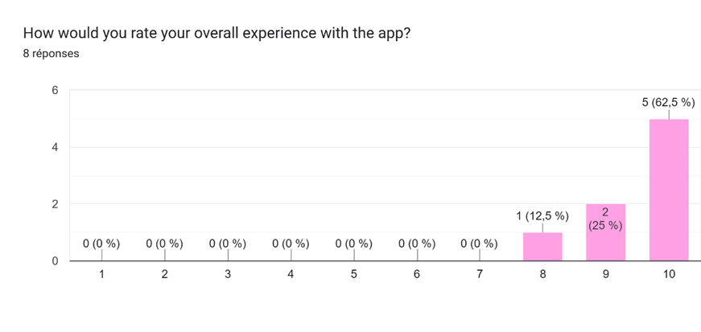
Testing, Evaluation and Iterative improvements (2/2)
Testing method 2: Post-Testing Survey
8 testers ( 2 Professors at ESIB and 6 students) have tried-out the SmartCloset App, then they filled a short survey anonymously, here are some suggestion for our project:
Desire to browse friends’ closets for inspiration
Automatic “check-out” of worn items
Add accessories section

Slide 25

Solution Impact
Global & Local Impact
Promotes sustainable fashion & mindful use
Reduces clothing waste by making forgotten items visible
Encourages donation (especially in Lebanon)
Economic Impact
Saves money by maximizing outfit reuse
Fights overconsumption
Environmental Impact (UN SDG 12):
➕Less textile waste, lower fashion footprint
➖AI training consumes energy -> CO₂ emissions
Notes:
Mne7ke les details et les explication comme dans le rapport

Slide 26
Conclusion (1/2)
What We've Achieved So Far
System Setup: Connected mobile app, AI model, Supabase & PostgreSQL
Database: Clean relational structure in PostgreSQL
Visual Similarity Engine: Matches clothing items visually ("find similar" feature)
Recommendation System: Combines metadata, color theory & probability for outfit suggestions
AI Training: YOLOv8 model recognizing clothes
Mobile App: Fully functional – Add/Remove Clothes, Closet/Outfit History, Stats, Suggestions
IoT: Automated item removal from closet
What’s Coming Next
Complete AI Training: Improve accuracy, add labels & personalize to user style
Weather & Calendar Integration: Smarter outfit suggestions
Custom Backend: Move beyond Supabase
Storage Cleanup: Remove unused images & old records

Slide 27

Conclusion (2/2)
We would like to express our sincerest gratitude to our supervisor, Dr. Hanan Farhat, for her constant support, guidance, and motivation throughout this project.
We're also grateful to each other, the Smart Closet team, for the effort, collaboration, and friendship that brought this project to life.

Slide 28
THANK YOU!
Q&A

